Slide 1

Grammar
Grammar:
G= (V, T, P, S) or
V- set of variables or set of non terminals
T- set of terminals
P-set of productions
S-starting symbol

Slide 2
Example of Grammar
Grammar – Example
Grammar G = ({S}, {0,1}, P, S}
Where P = { S→0S1, S→є}

Slide 3
Chomsky Hierarchy of Languages
Chomsky Hierarchy of Languages
Chomsky languages are classified based on four types of grammars
Type 0 (or phrase structured grammar)
Type 1 (or context sensitive grammar)
Type 2 (or context free grammar)
Type 3 (or regular grammar)

Slide 4
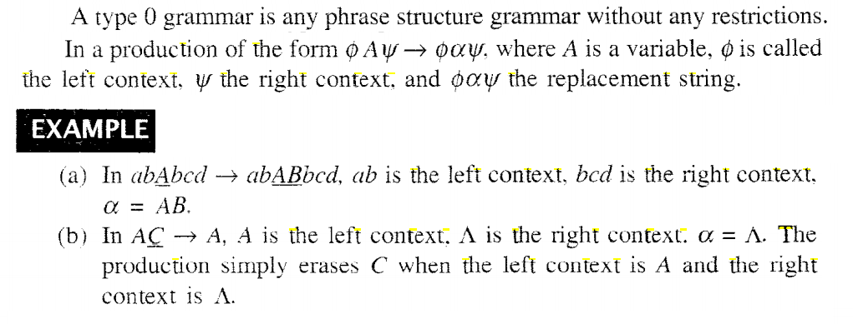
Chomsky Hierarchy of Languages
Type 0 (or phrase structured grammar)

Slide 5
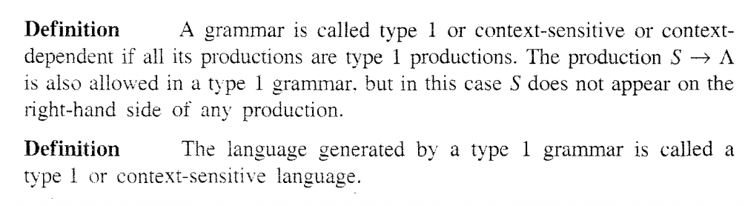
Chomsky Hierarchy of Languages
Type 1 (or Context sensitive grammar)

Slide 6
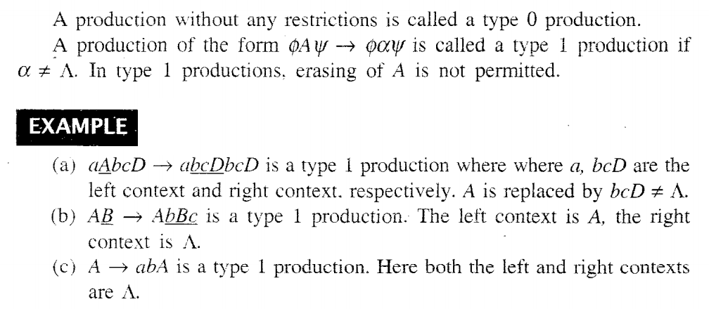
Chomsky Hierarchy of Languages
Type 1 (or Context sensitive grammar)

Slide 7
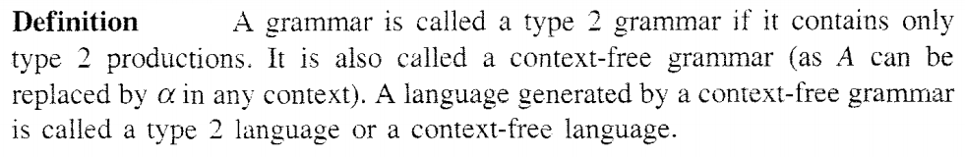
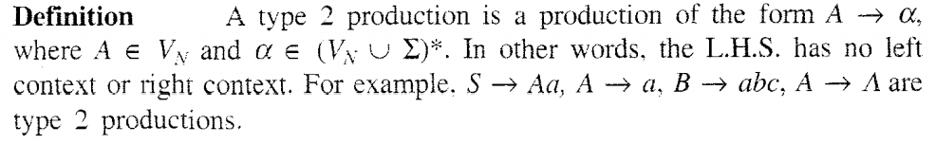
Chomsky Hierarchy of Languages
Type 2 (or Context free grammar)

Slide 8
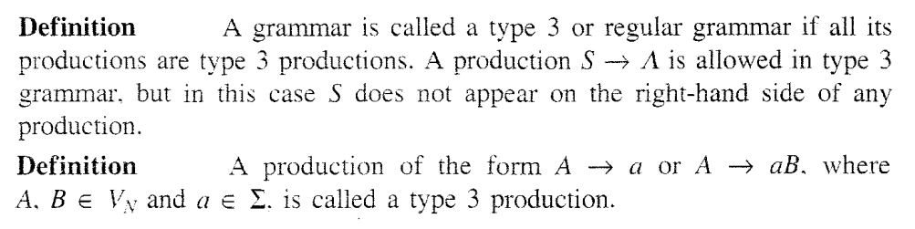
Chomsky Hierarchy of Languages
Type 3 (or Regular grammar)

Slide 9
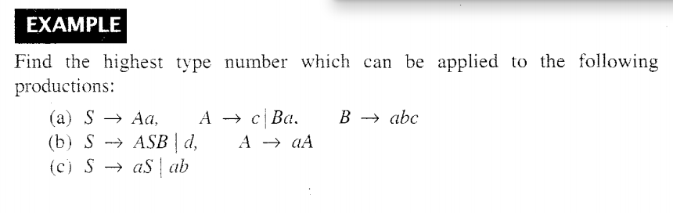
Chomsky Hierarchy of Languages

Slide 10
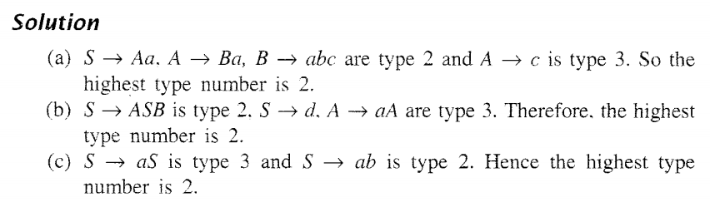
Chomsky Hierarchy of Languages

Slide 11
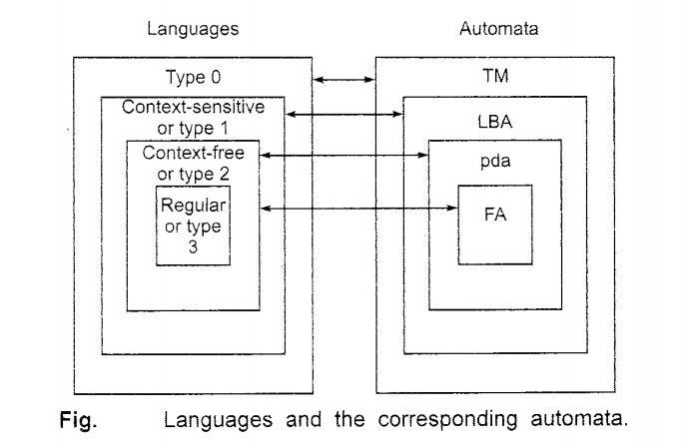
Chomsky Hierarchy of Languages

Slide 12
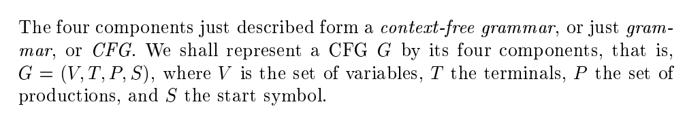
Context Free Grammar
In CFG, every production is in the form of A→α,
where A is a Variable and α is the combination of variables and terminals or empty symbol

Slide 13
Context Free Grammar : Example
Construct the CFG for the Language {0^{n} 1^{n} / n>=0}
Solution:
productions are S→0S1 / є
CFG G =({S, {0,1}, {S→0S1, S→ є}, S)
Example Derivation:
1. S=>0S1 2. S=> є belongs to given Language (n=0)
=> 00S11
=>000S111
=>000 є111
=>000111 belongs to given language (n=3)

Slide 14
Context Free Grammar : Example
2. Construct the CFG for the Language {0^{n} 1^{n} / n>=1}
Solution:
productions are S→0S1 / 01
CFG G =({S, {0,1}, {S→0S1, S→ є}, S)
Example Derivation:
1. S=>0S1 2. S=>01 belongs to given Language (n=1)
=> 00S11
=>000S111
=>000 01111
=>00001111 belongs to given Language (n=4)

Slide 15
Context Free Grammar : Exercise
3. Construct the CFG for the Language {1^{n} 0^{n} / n>=1}
4. Construct the CFG for equal number of a’s and b’s over the alphabet {a,b}. Test the string aabbba.
Solution:
S→SS
S→ є
S→aSb
S→bSa
Test the string aabbba:
S=>SS
S=>aSbS (rule 3)
S=>aaSbbS (rule 3)
S=>aa є bb S(rule 2)
S=>aabbbSa (rule 4)
S=>aabbb є a=>aabbba

Slide 16
Context Free Grammar : Exercise
5. Construct the CFG for the Language {0^{n} 1^{n+1} / n>=0}. Test the string 00111 with derivations
Solution:
S→A1
A→0A1
A→ є
CFG G=({S,A}, {0,1}, {S→A1,A→0A1,A→ є}
Testing string : 00111
S=>A1 (rule1)
S=>0A11 ( rule 2)
S=>00A111 (rule 2)
S=>00 є111 (rule 3)
S=>00111 € L(G). Thus, string is accepted with the grammar G.

Slide 17
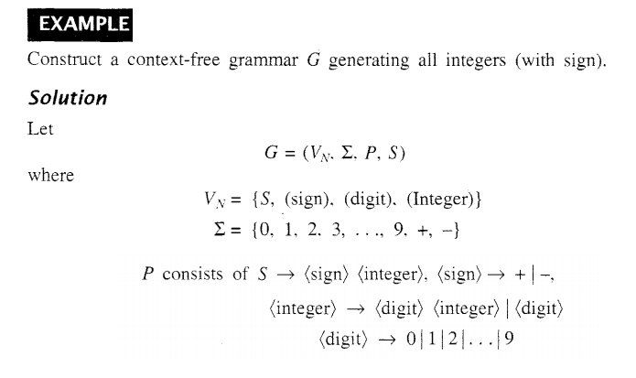
Context Free Grammar: Example

Slide 18
Context Free Grammar (CFG): Example
Construct a CFG for palindromes over the alphabet {0,1}
Ans:
S→є
S→0
S→1
S→0S0
S→1S1
Grammar G=(V,T,P,S)
Where V={S}
T={0,1}
P= {S→є, S→0, S→1, S→0S0, S→1S1}
S= S

Slide 19
Derivations – Left most derivations and Right Most Derivations
A derivation uses the productions of a grammar to replace non terminals (or variables) until there are only terminals left.
Left most derivation (LMD) − A leftmost derivation is obtained by applying production to the leftmost variable in each step.
Right most derivation (RMD)− A rightmost derivation is obtained by applying production to the rightmost variable in each step

Slide 20
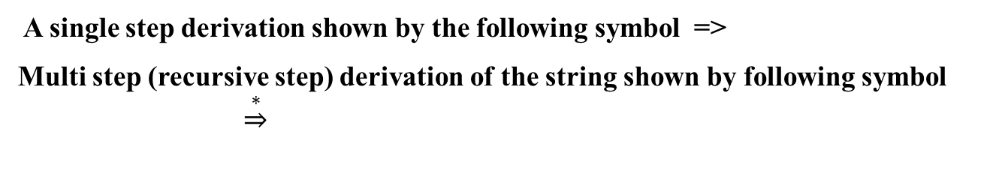
Derivations – Left most derivations and Right Most Derivations
A derivation uses the productions of a grammar to replace non terminals (or variables) until there are only terminals left.
A single step derivation shown by the following symbol =>
Multi step (recursive step) derivation of the string shown by following symbol $\underset{⇒}{∗}$
Left most derivation (LMD) − A leftmost derivation is obtained by applying production to the leftmost variable in each step.
Right most derivation (RMD)− A rightmost derivation is obtained by applying production to the rightmost variable in each step

Slide 21
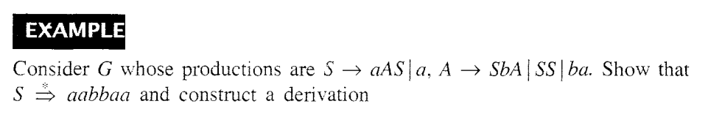
Left most derivations and Right Most Derivations: Example

Slide 22
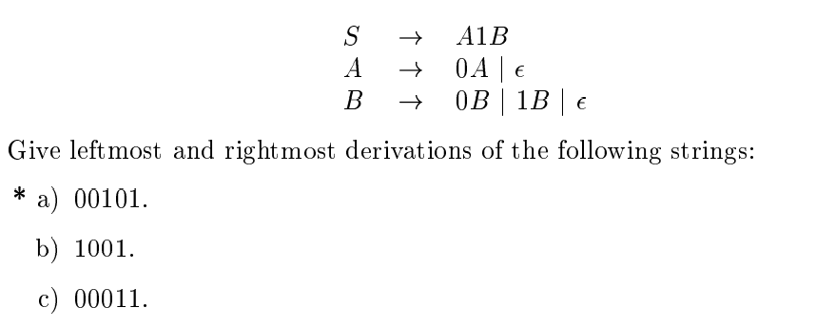
Left most derivations and Right Most Derivations: Example

Slide 23
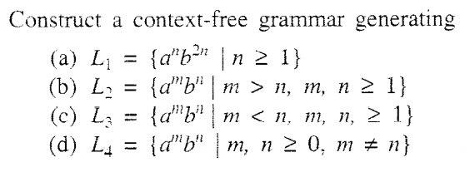

Questions of Context Free Grammars

Slide 24
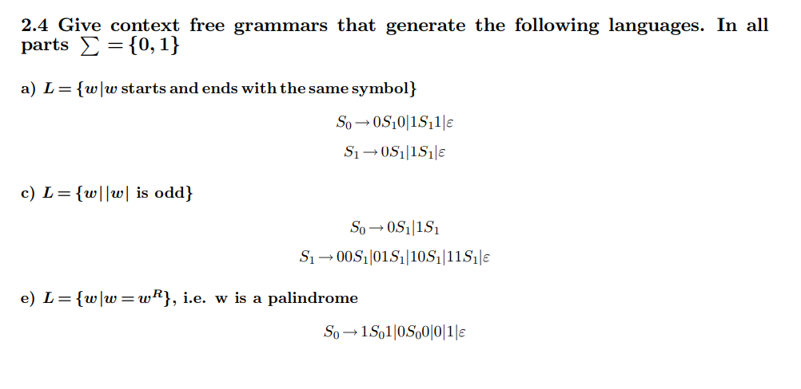
Context Free Grammars Examples

